Slide 1
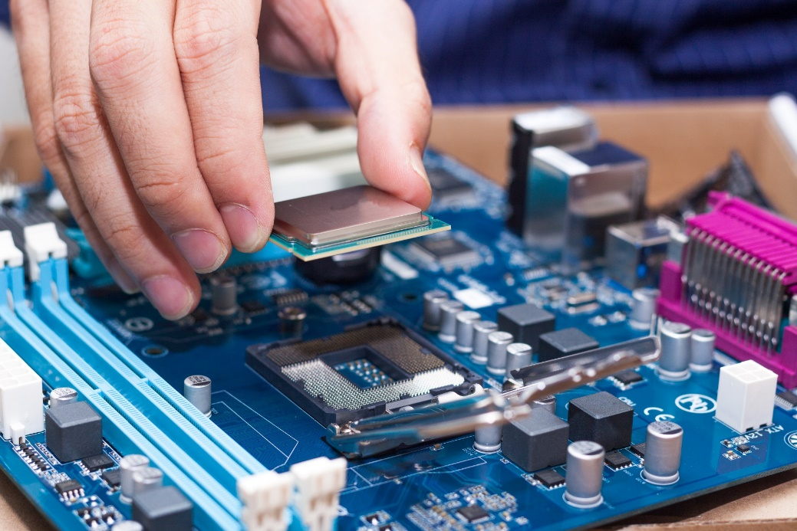
Java Native Interface (JNI)
Native methods
JNIH
C++ Example
Loading Shared Libraries

Slide 2
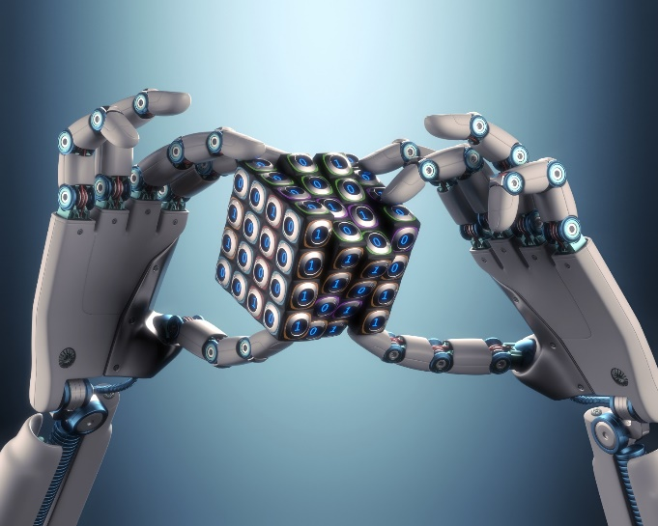
See Also
https://newcircle.com/bookshelf/java_fundamentals_tutorial/_java_native_interface_jni
https://www.youtube.com/watch?v=vmRUqajLIuM
Notes:
Here are some additional tutorials and videos to accompany this lesson.
<PAUSE>

Slide 3
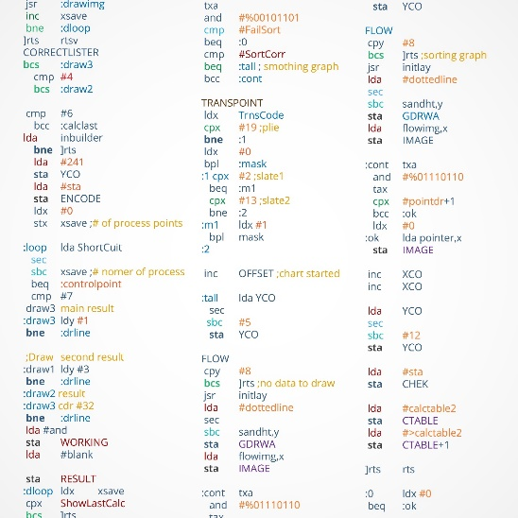
Calling out to Native Code
public class Speaker {
public void speakUp() {
sayHi();
sayBye();
}
public native void sayHi();
public native void sayBye();
}
MyLibrary.DLL
You can mix natives and regular methods
Java library has many native calls (like starting a thread)
Streams of bytes … two ways (into your program and out of your program)
Disks, consoles, sockets, keyboards, printers
Know how to talk streams and you can talk to anything
Initialization (constructor) is different. Use is the same.
Notes:
You use native methods like any other method.
@1 You link your program to a shared library for the platform : DLL on windows or SO on linux
@2 When you call a native method the JVM calls out to the native executable code in the library.
From a “using” point of view there is no difference. You call a method and when it is done it returns to you.
@3 You can mix native and regular methods as shown here. Most of the java library is pure java code.
@4 But there are many native methods to call out to the native library linked with the JVM … like starting threads

Slide 4

Why Would You?
You have existing code in another language
You need the speed of native processing
You need to access hardware
Streams of bytes … two ways (into your program and out of your program)
Disks, consoles, sockets, keyboards, printers
Know how to talk streams and you can talk to anything
Initialization (constructor) is different. Use is the same.
Notes:
Why would you ever want to use anything but Java?
@1 You might have a large body of existing code you want to integrate into your java application.
@2 You need to do some fast processing … graphics or scientific computation. The “hot spot” compiler makes this less of a compelling reason.
@3 You need access to hardware. Maybe you are running embedded java on the raspberry pi and need access to the GPIO pins. Maybe you are on a windows machine and need access to a USB device.

Slide 5
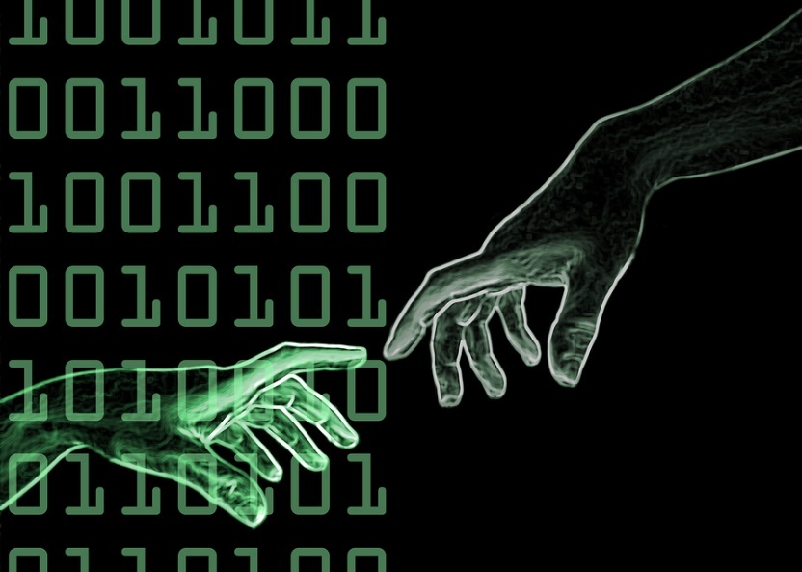
Platform Specifics
You must ship different libraries for different hardware
You must ship different libraries for 32 and 64 bits
Might be difficult to debug
Streams of bytes … two ways (into your program and out of your program)
Disks, consoles, sockets, keyboards, printers
Know how to talk streams and you can talk to anything
Initialization (constructor) is different. Use is the same.
Notes:
There are some difficulties
@1 The native code is platform specific. You have to make shared libraries for all the supported platforms.
@2 Different architectures need different libraries. For instance, if you are running a 64 bit JVM then you need a 64 bit DLL.
@3 Debugging multi-language code might be difficult.

Slide 6

Drinking from the C++ Fire Hose
Very quick instructions on getting C++ up and going in eclipse
The tools change nearly every day
Open the “JNITinker” Eclipse workspace on your desktop
Skip through this lecture if you like!
Streams of bytes … two ways (into your program and out of your program)
Disks, consoles, sockets, keyboards, printers
Know how to talk streams and you can talk to anything
Initialization (constructor) is different. Use is the same.
Notes:
This is NOT a course on C++. You aren’t going to learn C++.
@1 This will give you an idea of the “barrier to entry” for C++ development environment. You should see how to dock to external native code even if you ignore the C++ here.
@2 The installation instructions are different for different platforms. And the installers and instructions change a little with each release. You might have to do some web searching if you get serious.
@3 All the tools are installed on your classroom VM. Just open the workspace on your desktop to tinker.
@4 Or just skim through this topic. There are no lab assignments. This is just to give you a glimpse.

Slide 7
Msys64 (Bash Shell For Windows)
https://msys2.github.io/
Only needed for installing the compiler
Download the 86_64 installer and run it
In the msys shell type the command:
pacman --needed -Sy bash pacman pacman-mirrors msys2-runtime
Close the shell window and reopen it (c:\msys64\mingw64_shell.bat)
pacman -Su
Streams of bytes … two ways (into your program and out of your program)
Disks, consoles, sockets, keyboards, printers
Know how to talk streams and you can talk to anything
Initialization (constructor) is different. Use is the same.
Notes:
For windows
@1 Use the defaults

Slide 8
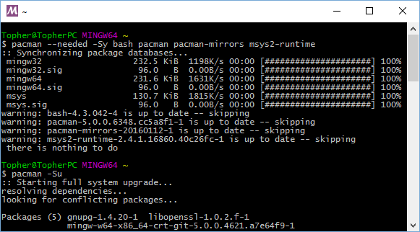
Msys64 (Bash Shell For Windows)
Streams of bytes … two ways (into your program and out of your program)
Disks, consoles, sockets, keyboards, printers
Know how to talk streams and you can talk to anything
Initialization (constructor) is different. Use is the same.

Slide 9
MinGW-x64 (Compiler)
In the msys shell type the command:
pacman -S mingw-w64-x86_64-gcc
Use the windows file explorer to copy c:\msys64\ming64 to c:\mingw
Add c:\mingw\bin to the windows PATH
Streams of bytes … two ways (into your program and out of your program)
Disks, consoles, sockets, keyboards, printers
Know how to talk streams and you can talk to anything
Initialization (constructor) is different. Use is the same.
Notes:
For windows
@1 Use the defaults

Slide 10
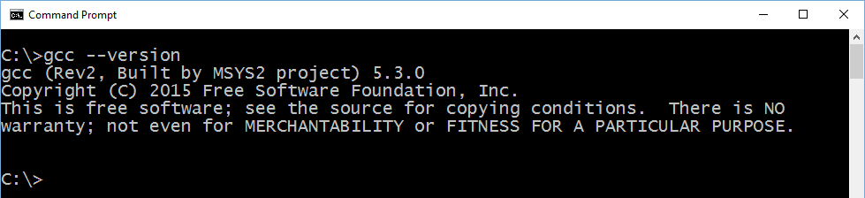
MinGW-x64 (Compiler)
Close the msys shell
Open a new windows command prompt
Type the command "gcc --version"
Streams of bytes … two ways (into your program and out of your program)
Disks, consoles, sockets, keyboards, printers
Know how to talk streams and you can talk to anything
Initialization (constructor) is different. Use is the same.

Slide 11
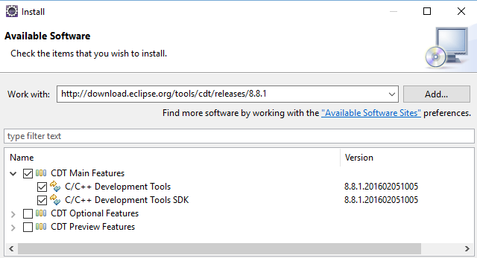
CDT For Eclipse
http://www.eclipse.org/cdt/downloads.php
In eclipse Help->Install New Software
Copy the latest “p2 software repository” link
Streams of bytes … two ways (into your program and out of your program)
Disks, consoles, sockets, keyboards, printers
Know how to talk streams and you can talk to anything
Initialization (constructor) is different. Use is the same.

Slide 12
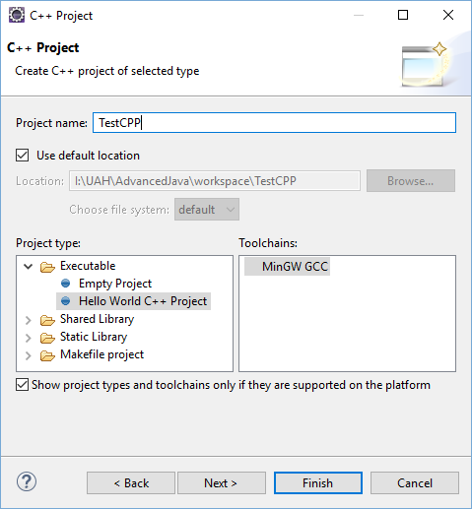
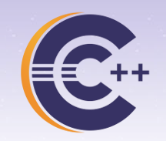
CDT For Eclipse
Restart Eclipse
New Project – C++ Project
Streams of bytes … two ways (into your program and out of your program)
Disks, consoles, sockets, keyboards, printers
Know how to talk streams and you can talk to anything
Initialization (constructor) is different. Use is the same.

Slide 13
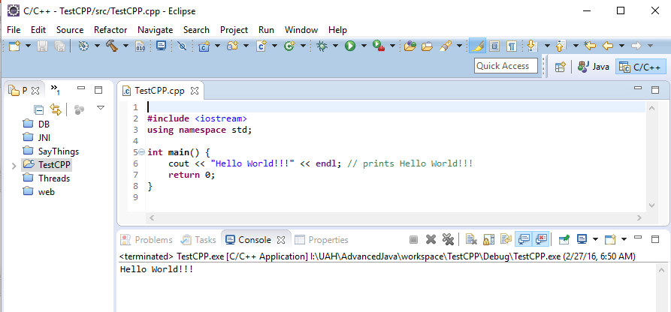
CDT For Eclipse
Streams of bytes … two ways (into your program and out of your program)
Disks, consoles, sockets, keyboards, printers
Know how to talk streams and you can talk to anything
Initialization (constructor) is different. Use is the same.

Slide 14
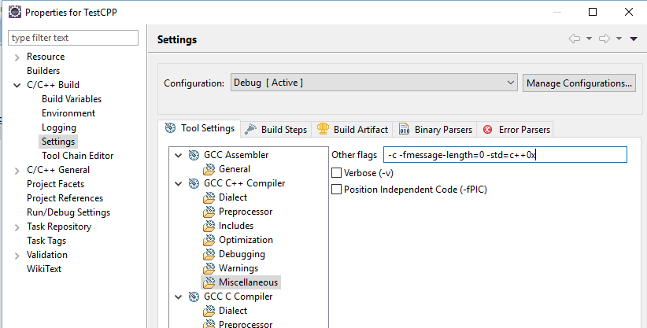
CDT For Eclipse
Streams of bytes … two ways (into your program and out of your program)
Disks, consoles, sockets, keyboards, printers
Know how to talk streams and you can talk to anything
Initialization (constructor) is different. Use is the same.
Notes:
C++ 11

Slide 15
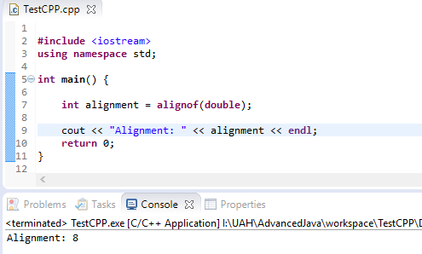
CDT For Eclipse
Streams of bytes … two ways (into your program and out of your program)
Disks, consoles, sockets, keyboards, printers
Know how to talk streams and you can talk to anything
Initialization (constructor) is different. Use is the same.
Notes:
C++ 11

Slide 16
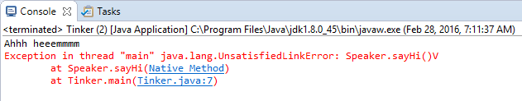
javah
public class Speaker {
public void clearThroat() {
System.out.println("Ahhh heeemmmm");
}
public void speakUp() {
sayHi();
sayBye();
}
public native void sayHi();
public native void sayBye();
}
public class Tinker {
public static void main(String[] args) {
Speaker s = new Speaker();
s.clearThroat();
s.sayHi();
s.sayBye();
}
}
Streams of bytes … two ways (into your program and out of your program)
Disks, consoles, sockets, keyboards, printers
Know how to talk streams and you can talk to anything
Initialization (constructor) is different. Use is the same.
Notes:
Regular old java class.
@1 method with a print statement
@2 two methods … but not in java. We’ll write these in C++
@3 to the rest of the world these are plain old callable java methods
@4 Try it out with a test main
Notice the code compiles just fine! The java compiler doesn’t know whether you’ve linked in a shared library or not. That error won’t happen until runtime.
@5 We get the message printed. As soon as we try to call “sayHi” the JVM looks for native code and doesn’t find it.

Slide 17
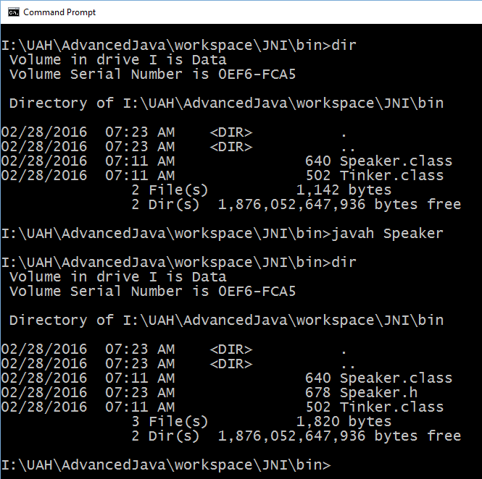
javah
Streams of bytes … two ways (into your program and out of your program)
Disks, consoles, sockets, keyboards, printers
Know how to talk streams and you can talk to anything
Initialization (constructor) is different. Use is the same.

Slide 18

Speaker.h
/* DO NOT EDIT THIS FILE - it is machine generated */
#include <jni.h>
/* Header for class Speaker */
#ifndef _Included_Speaker
#define _Included_Speaker
#ifdef __cplusplus
extern "C" {
#endif
/*
* Class: Speaker
* Method: sayHi
* Signature: ()V
*/
JNIEXPORT void JNICALL Java_Speaker_sayHi(JNIEnv *, jobject);
/*
* Class: Speaker
* Method: sayBye
* Signature: ()V
*/
JNIEXPORT void JNICALL Java_Speaker_sayBye(JNIEnv *, jobject);
#ifdef __cplusplus
}
#endif
#endif
Streams of bytes … two ways (into your program and out of your program)
Disks, consoles, sockets, keyboards, printers
Know how to talk streams and you can talk to anything
Initialization (constructor) is different. Use is the same.
Notes:
@1 standard C/C++ header file magic.
@2 Here is “sayHi” it returns nothing (void). It takes TWO parameters. The first is a pointer to the JVM itself. So you can call functions on the JVM like to create objects, call java methods, and chase pointers. The second is “this”. In Java it is implicitly passed in all method calls.
@3 And “sayBye”
@4 All of these types … “JNIEnv”, “jobject”, “JNIEXPORT”, and “JNICALL” are defined in the “jni.h” header file in the JDK directory. These are all very platform specific – delivered as part of the JDK you installed.

Slide 19
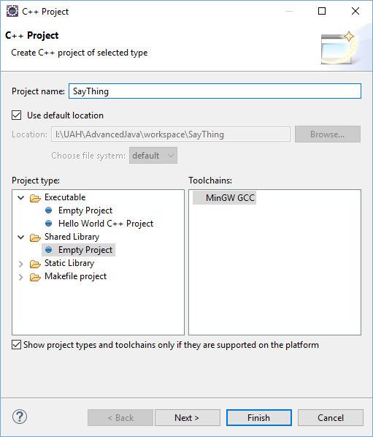
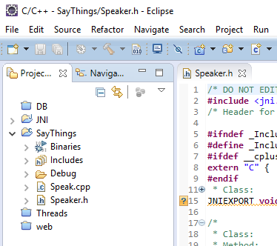
Making a Windows DLL
Streams of bytes … two ways (into your program and out of your program)
Disks, consoles, sockets, keyboards, printers
Know how to talk streams and you can talk to anything
Initialization (constructor) is different. Use is the same.

Slide 20
Making a Windows DLL
#include <iostream>
using namespace std;
#include "Speaker.h"
JNIEXPORT void JNICALL Java_Speaker_sayHi(JNIEnv *vm, jobject me) {
cout << "Hello there" << endl;
}
JNIEXPORT void JNICALL Java_Speaker_sayBye(JNIEnv *, jobject) {
cout << "Bye now" << endl;
}
Streams of bytes … two ways (into your program and out of your program)
Disks, consoles, sockets, keyboards, printers
Know how to talk streams and you can talk to anything
Initialization (constructor) is different. Use is the same.
Notes:
We start with the prototypes defined in Speaker.h and make a CPP file.
@1 Simple print statements
@2 And more C++ include magic for cout

Slide 21
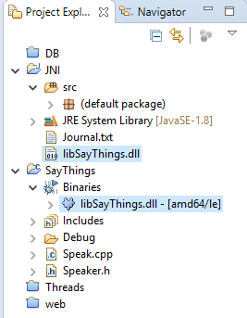
Making a Windows DLL
DLL must be accessible
PATH (not classpath)
In your JAR file
Current Working Directory
Streams of bytes … two ways (into your program and out of your program)
Disks, consoles, sockets, keyboards, printers
Know how to talk streams and you can talk to anything
Initialization (constructor) is different. Use is the same.
Notes:
I just copied it to the project directory. This is the CWD when you run it in eclipse.

Slide 22
Loading the DLL in Java
public class Speaker {
static {
System.loadLibrary("libSayThings");
}
public void clearThroat() {
System.out.println("Ahhh heeemmmm");
}
public void speakUp() {
sayHi();
sayBye();
}
public native void sayHi();
public native void sayBye();
}
No file name “extension”
Load it with the class
Streams of bytes … two ways (into your program and out of your program)
Disks, consoles, sockets, keyboards, printers
Know how to talk streams and you can talk to anything
Initialization (constructor) is different. Use is the same.
Notes:
You must tell the JVM to load your shared library. You must execute this command BEFORE you try and use the native methods.
@1 Notice there is no file name extension. The JVM will tack on the appropriate extension: DLL for windows, SO for linux, etc. This allows you deploy different binary files for different platforms, but the name in the code is the same.
You can put this in main. You can call it yourself wherever you like.
@2 A good place (the traditional place) is to put the load in a “static” block inside the class. When the class is first loaded into the JVM then the static block runs and loads the library for the native code. This assures that the DLL is loaded along with the java code … at the same time.
@3 The Speaker class is now complete.

Slide 23
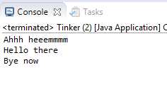
Loading the DLL in Java
public class Tinker {
public static void main(String[] args) {
Speaker s = new Speaker();
s.clearThroat();
s.sayHi();
s.sayBye();
}
}
Streams of bytes … two ways (into your program and out of your program)
Disks, consoles, sockets, keyboards, printers
Know how to talk streams and you can talk to anything
Initialization (constructor) is different. Use is the same.

Slide 24
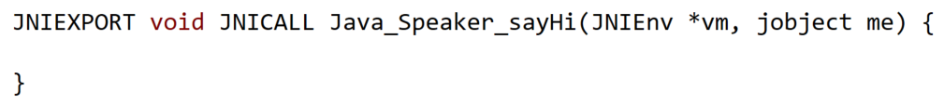
Accessing the JVM
Native code can do everything Java code can:
Create objects on the heap
Use “this”
Call methods on objects
Call static methods
public class Speaker {
...
public native int doStuff(int a);
}
Streams of bytes … two ways (into your program and out of your program)
Disks, consoles, sockets, keyboards, printers
Know how to talk streams and you can talk to anything
Initialization (constructor) is different. Use is the same.

Slide 25
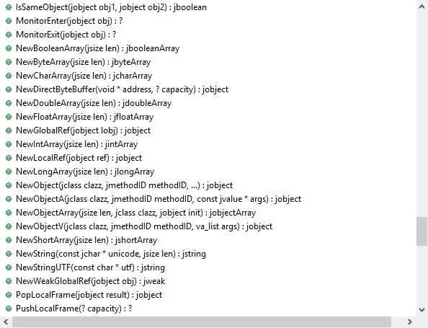
Accessing the JVM
JNIEXPORT jint JNICALL Java_Speaker_doStuff (JNIEnv * env, jobject me, jint i) {
env->
cout << "IN DO STUFF WITH " << i << endl;
return 22;
}
Streams of bytes … two ways (into your program and out of your program)
Disks, consoles, sockets, keyboards, printers
Know how to talk streams and you can talk to anything
Initialization (constructor) is different. Use is the same.

Slide 26
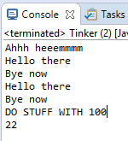
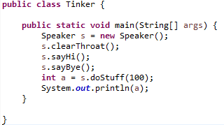
Accessing the JVM
JNIEXPORT jint JNICALL Java_Speaker_doStuff (JNIEnv * env, jobject me, jint i) {
jclass classID = env->GetObjectClass(me);
jmethodID mid = env->GetMethodID(classID, "speakUp","()V");
env->CallVoidMethod(me, mid);
cout << "DO STUFF WITH " << i << endl;
return 22;
}
Streams of bytes … two ways (into your program and out of your program)
Disks, consoles, sockets, keyboards, printers
Know how to talk streams and you can talk to anything
Initialization (constructor) is different. Use is the same.

Slide 27
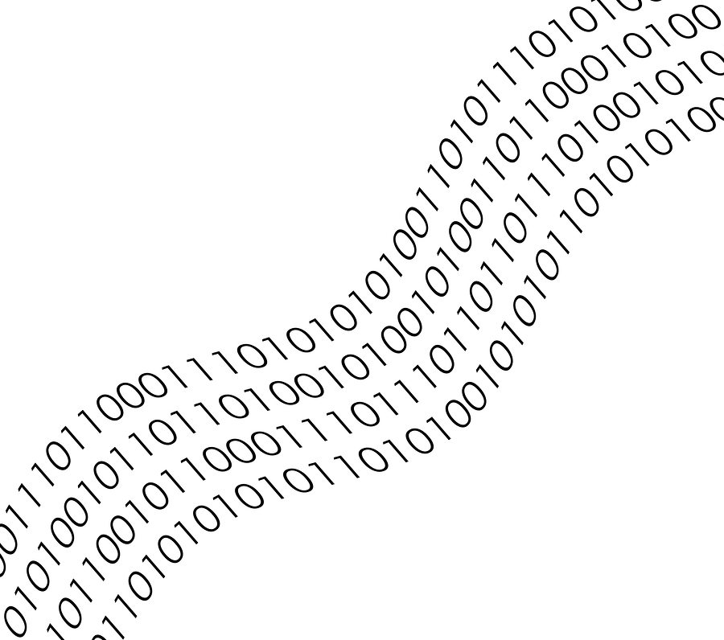
Tinkering
Change the messages in Speaker.cpp, recompile the DLL, and test.
Add a native function to return the sum of two int parameters.
Notes:
Reference the discussion area

